Slide 1
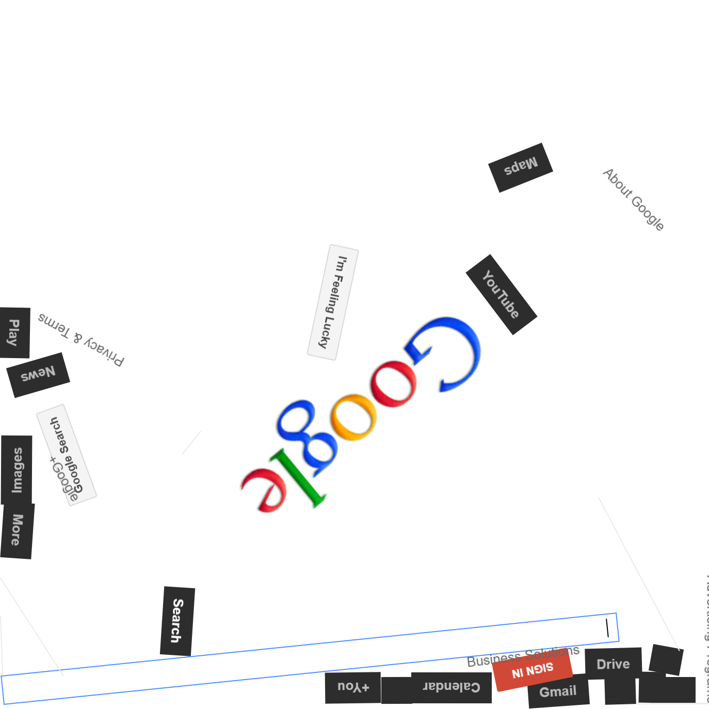
CSIT5930 Search Engine
A Full-Featured Search Engine with BFS Crawling, TF-IDF Ranking, and Phrase Search
Prepared by,
1.
2.
3. TURTAYEV Yerlan (21262869)

Slide 2
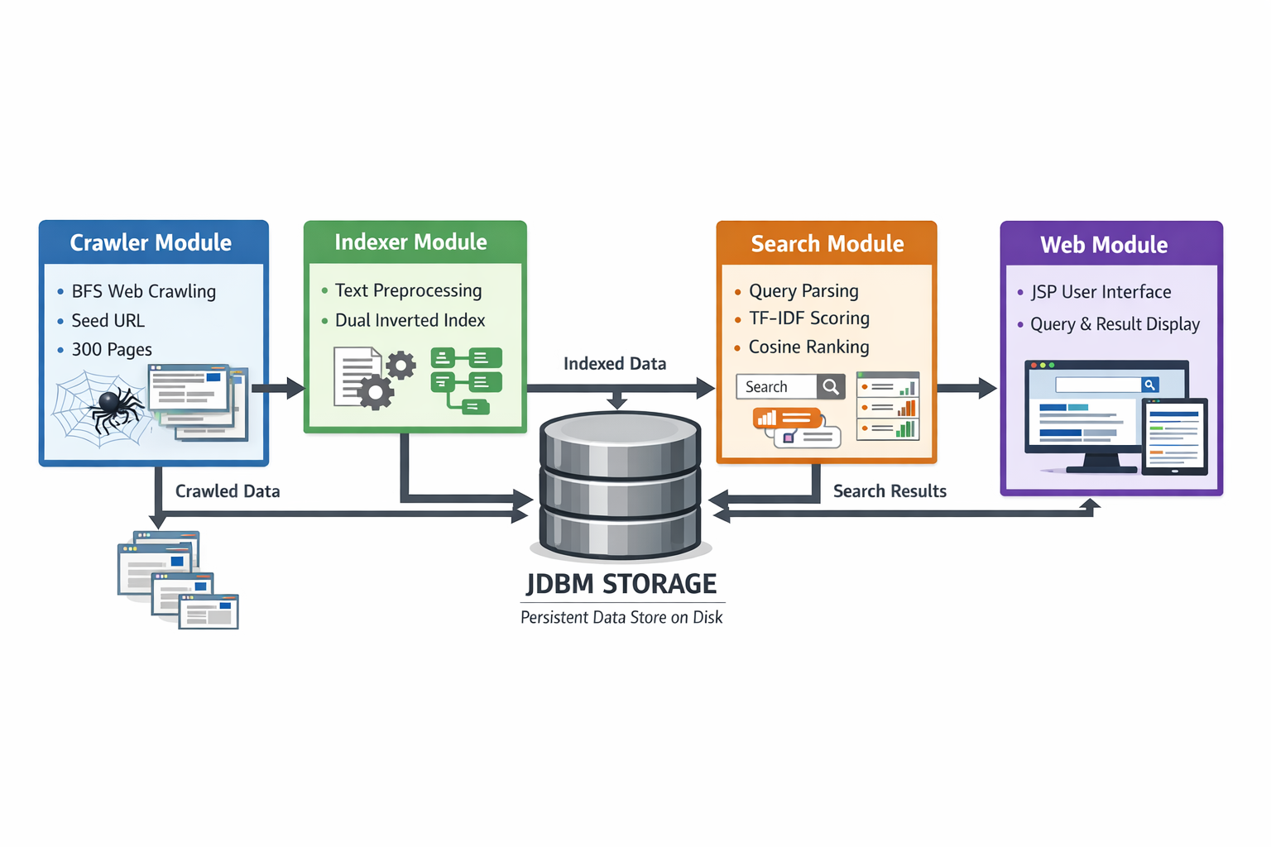
System Architecture Overview
Four Main Modules: Crawler Module, Indexer Module, Search Module , Web Module
Data flow: Crawler → Indexer → JDBM Storage ← Search Engine ← Web Interface
JDBM as the central data store - all core data persisted to disk (no in-memory storage)

Slide 3
Index Database File Structure
JDBM-based persistent storage with 8 separate HTrees: - `url2id` - URL to PageID mapping (bidirectional with id2url) - `id2url` - PageID to URL mapping - `parentLinks` - Child-to-parent page relationships - `childLinks` - Parent-to-child page relationships - `titleIndex` - Title inverted index (stem → PostingList) - `bodyIndex` - Body inverted index (stem → PostingList) - `pageMetadata` - Page metadata for result display - `systemConfig` - System counters (totalDocs, nextPageId)
PostingList structure: HashMap<PageID, PostingEntry>
PostingEntry fields: pageId, termFrequency, maxTermFrequency, positions[]
Two completely independent inverted indexes for title and body

Slide 4
Core Algorithms - Text Preprocessing
Pipeline (applied consistently for both indexing and querying): 1. Convert to lowercase 2. Tokenize by non-alphabetic characters 3. Filter stopwords using course-provided stopwords.txt 4. Apply Porter Stemming Algorithm (Lab3 implementation) 5. Record position information for phrase search
Position tracking enables phrase search across both title and body

Slide 5
Core Algorithms - TF-IDF and Cosine Similarity
TF-IDF Formula: - `TF-IDF = (tf × idf) / max(tf)` - `idf = ln(N / df)` - tf = term frequency in document - max(tf) = maximum term frequency across all terms in document - N = total number of documents, df = document frequency
Cosine Similarity: - `cos(q, d) = (q · d) / (|q| × |d|)` - Query and document represented as TF-IDF weight vectors
Title Boost Mechanism: - Effective weight = body_tfidf + title_tfidf × TITLE_BOOST_FACTOR (3.0) - Title matches significantly boost page ranking

Slide 6
Core Algorithms - Phrase Search
Double-quoted phrase support: e.g., `"hong kong" universities`
Implementation using position-based matching: 1. Parse quoted phrases from query 2. Look up posting lists for each phrase term 3. Find candidate documents (intersection of posting lists) 4. Verify consecutive positions: term[i+1] at position(term[i]) + 1
Searches both title and body indexes for phrase matches
Combined with regular term matching for mixed queries

Slide 7
BFS Crawling Strategy
Breadth-First Search starting from seed URL
Three mandatory pre-crawl checks: 1. Circular link protection (skip already-processed URLs) 2. Index existence check (allow new URLs) 3. Page update check (re-crawl if modified since last index)
Metadata extraction: title, body, links, Last-Modified, page size
Fallback logic: current time if no Last-Modified header; content length from HTML if no Content-Length
Periodic JDBM commits (every 50 pages) for crash recovery

Slide 8
Crawler Profiling
WEB CRAWLER PERFORMANCE ANALYSIS
Total Time: | ~5,971 ms (6.0 seconds)*
Pages Crawled: | 297
Throughput: | ~49.7 pages/second*
Database Size: | 18.7 MB (19,652,608 bytes)
Links Discovered: | 588
Errors: | 0
*varies with network speed

Slide 9
Crawler Profiling
PHASE BREAKDOWN
Phase | Time (ms) | Percentage
HTTP Fetching | 3,277 | 54.9%
Page Indexing | 1,849 | 31.0%
Database Commits | 773 | 12.9%
Link Processing | 52 | 0.9%
URL Validation | 11 | 0.2%
ID Mapping | 2 | 0.0%
Other Overhead | 7 | 0.1%
TOTAL | 5,971 | 100%

Slide 10
Installation and Running Steps
1. Prerequisites: Java 8+, Maven 3.6+ 2. Build: `mvn clean package` 3. Install dependencies: htmlparser 2.1, JDBM 1.0 (via Maven or local install) 4. Run crawler: `mvn exec:java -Dexec.mainClass="hk.ust.csit5930.search.crawler.Spider"` 5. Build image using Dockerfile: docker build -t search-engine . 6. Run the container: docker run -d -p 8080:8080 --name search-engine search-engine
Access: http://localhost:8080/

Slide 11
Enhancement - Get Similar Pages
Relevance feedback feature
How it works: 1. User clicks "Get Similar Pages" button on any search result 2. System extracts top 5 keywords (stems) from that page's metadata 3. Keywords are used to construct an automatic search query 4. Results show pages similar to the selected page
Design principle: Reuses existing SearchEngine logic, no code duplication
Practical use: Helps users discover related content without reformulating queries

Slide 12
Test Results and Demo
Test scenarios: - Single keyword search: "algorithm" → relevant results with scores - Multi-keyword search: "computer science" → combined ranking - Phrase search: `"hong kong"` → position-verified consecutive matches - Mixed queries: `"data mining" research` → phrase + individual term - Similar pages: click button → related pages displayed
Performance metrics: - 300 pages crawled successfully - Index built with dual inverted indexes - Sub-second search response time
(Include screenshots of actual search results)

Slide 13
Conclusion
System Strengths: - Complete implementation of all assignment requirements - Efficient JDBM-based disk storage (no memory-only data structures) - Accurate phrase search with position-based matching - Title boost mechanism improves result relevance - Clean modular architecture with clear separation of concerns
Limitations: - Single-threaded crawler (could be parallelized) - No incremental index updates (full re-index required) - Basic web UI without advanced features (pagination, autocomplete)
Future Improvements: - Multi-threaded crawling for faster data collection - PageRank or HITS algorithm for link-based ranking - Query suggestion and auto-completion - Snippet generation with keyword highlighting - Support for non-English content and multi-language search

